Slide 1
COBOL-DB2 Program
DB2 Training Class 04

Slide 2
Required Steps
    Write a COBOL + DB2 program
    Compile the COBOL + DB2 program
    Execute the program.

Slide 3
Required Copybooks
    SQLCA copy book
    Host variable/DCLGEN copybook
Application program containing SQL statement should have SQLCA copybook. SQLCA copybook is a collection of variables that are updated for every SQL statement.
This copybook is of 136 bytes in length.
Contains most important variable like SQLCODE, SQLERRD
SQLCODE contain the status code after every Execution of SQL statement whose picture clause is S9(9) COMP-3.
SQLERRD is an occurs data item in which the 3 occurrence contains the number of effected rows by a given query i.e. SQLERRD(3).

Slide 4
Host variable
These are variable defined in the host language to use in application program.
Host Variable are the only means of moving data from and to DB2 tables
We use DCLGEN tool to produce host variable are the same as the column of the tables
We need to code host variables with in the SQL statement but should be preceded by colon (:).

Slide 5
Embedded SQL
All the SQL related statement should be coded/embedded in between
    EXEC SQL & END-EXEC.
Both SQLCA and host variable should be coded in between EXEC SQL and END-EXEC with INCLUDE Statement.
EXEC SQL EXEC SQL
  INCLUDE SQLCA INCLUDE DCLGEN
END-EXEC. END-EXEC.

Slide 6
Embedded SQL Statement
EXEC SQL INSERT INTO EMP_TAB(ENO,ENAME)
VALUES(:HS-ENO,:HS-ENAME)
END-EXEC.
EXEC SQL SELECT ENO,ENAME INTO :HS-ENO,:HS-ENAME FROM EMP_TAB WHERE ENO=001
END-EXEC.
EXEC SQL UPDATE EMP_TAB SET ENAME=:HS-ENAME
END-EXEC.
EXEC SQL DELETE FROM EMP_TAB WHERE ENO=:HS-ENO
END-EXEC.

Slide 7
Program Preparation
We need to follow few steps
  Precompile
  Compile & link
  Bind
    Package (BIND PACKAGE)
    Plan (BIND PLAN)

Slide 8
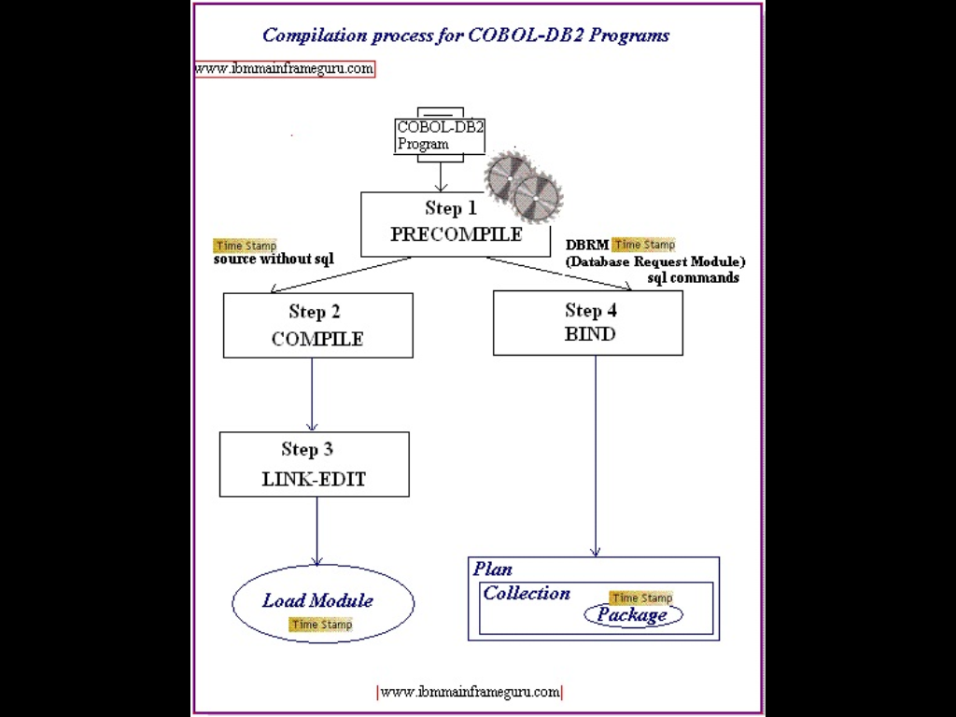

Slide 9
Precompile
Searches all the SQL statements and include members and comments out every SQL statements in the program
The SQL statement are replaced by a call statement along with the parameters
All SQL statements are extracted and put in a DBRM
Both SQLCA & DCLGEN copybooks are expanded in the pre compile process only.
It also assign a time stamp to the modified code and DBRM member.

Slide 10
Compile and Link
Modified COBOL code output is then compiled
Compiled code is then link edited to an Executable load module

Slide 11
BIND Process
A type of compiler for SQL statement using a pre written program i.e. IKJEFT01
It reads the SQL statement from the DBRM and produces a mechanism to access data as directed by the SQL statement
In this bind process it checks the syntax, checks for the correctness of the table & columns definitions against the catalog information and perform authentication validation
The output of the bind process can be a package or a plan

Slide 12
Package & its Advantage
Package is bound form of SQL statement
Advantages:
Reduced bind time
Can specify bind operation in the programmer level
Provide remote data access

Slide 13
PLAN
Package is not Executable where as plan is Executable
An application plan contain one or both of the following elements
  A list of package names
  The bound form of SQL statement taken from one or more DBRM
Every DB2 application requires an application plan
Plans are created using the DB2 sub command BIND PLAN

Slide 14
Bind Parameters

Slide 15
Bind Parameters
//SYSTSIN DD *
DSN SYSTEM(DB9G)
BIND PACKAGE(FSSTSOPK) MEMBER(DBRMMEM) -
OWNER(FSS197) QUALIFIER(FSS197) -
VALIDATE(BIND) ISOLATION(CS) -
RELEASE(COMMIT) ACTION(REPLACE) -
EXPLAIN(NO)
END
/*
//SYSTSIN DD *
DSN SYSTEM(DB9G)
BIND PLAN(FSS197PL) PKLIST(FSSTSOPK.*)
/*

Slide 16
Bind Parameters
PKLIST : PKLIST is a bind parameter of bind plan. Packages to be connected with plan are named here.
ACTION(ADD\REPLACE) package or plan is add or replaced. default is REPLACE.
ACQUIRE AND RELEASE :
  ACQUIRE(USE/ALLOCATE locks table and table space on use
  RELEASE(COMMIT/DEALLOCATE) release when the plan terminates
SQLERROR(NOPACKAGE/CONTINUE) it says weather to create the package in case of sql error
EXPLAIN(YES/NO) loads the access path selected by the optimzerin plan_table. no is default

Slide 17
Isolation Levels
Lost Updates: This event occurs when two transactions read the same data, both attempt to update that data, and one of the updates is lost.
Dirty Reads: This event occurs when a transaction reads data that has not yet been committed.
Nonrepeatable Reads: This event occurs when a transaction reads the same row of data twice, but gets different results each time
Phantoms. This event occurs when a row of data matches some search criteria but initially is not seen.

Slide 18
Isolation levels
      Repeatable Read
      Read Stability
      Cursor Stability
      Uncommitted Read

Slide 19
The Repeatable Read Isolation Level
The Repeatable Read isolation level is the most restrictive isolation level available.
When this isolation level is used, every row that is referenced in any manner by the isolated transaction is "locked" for the duration of that transaction.
Thus, if a transaction scans 1,000 rows in order to retrieve 10, locks are acquired and held on all 1,000 rows scanned—not just on the 10 rows retrieved.

Slide 20
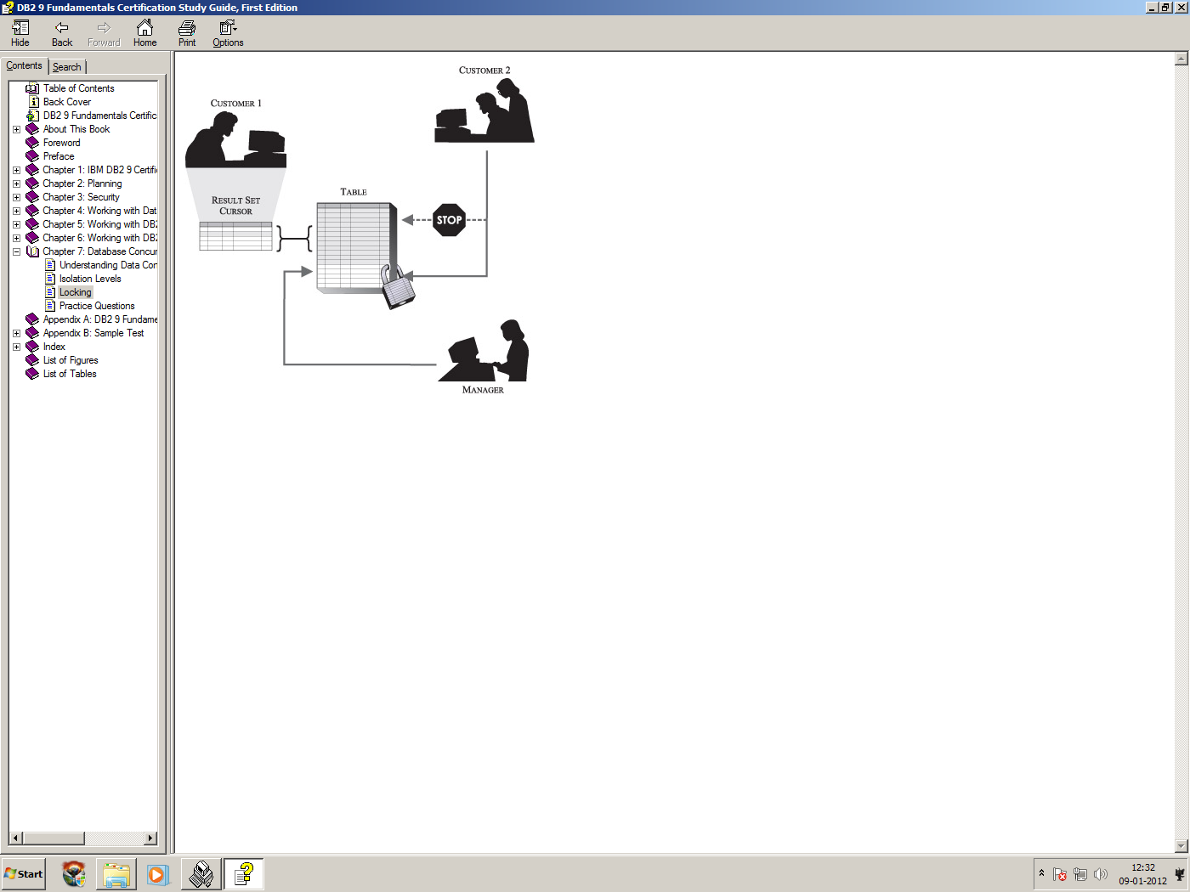

Slide 21
The Read Stability Isolation Level
when the Read Stability isolation level is used, only rows that are actually retrieved by a single transaction are locked for the duration of that transaction.
phantoms, however, can and may be seen but because of fewer locks are acquired, more transactions can run concurrently.
if a transaction scans 1,000 rows in order to retrieve 10, locks are only acquired and held on the 10 rows retrieved—not on all 1,000 rows scanned.

Slide 22
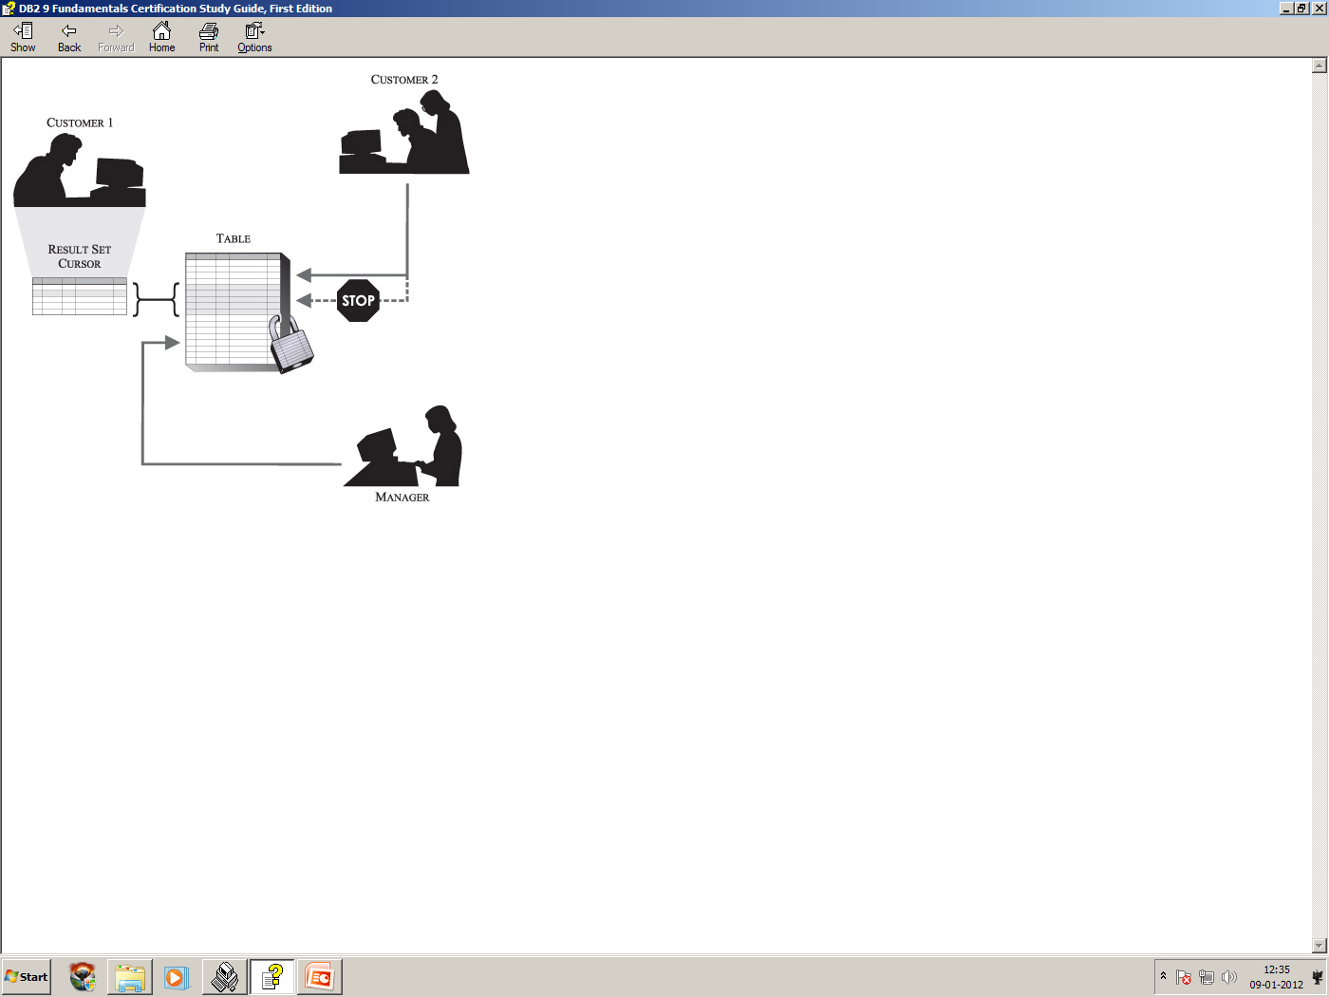

Slide 23
The Cursor Stability Isolation Level
When the Cursor Stability isolation level is used, only the row that is currently being referenced by a cursor is locked. The lock acquired remains in effect until the cursor is repositioned or until the isolating transaction terminates.
If the cursor is repositioned, the lock being held on the last row read is released and a new lock is acquired for the row the cursor is now positioned on..
Non repeatable reads and phantoms, on the other hand, can and may be seen.

Slide 24


Slide 25
The Uncommitted Read Isolation Level
The uncommitted read isolation level is the least intrusive isolation level provided.
In fact, when the uncommitted read isolation level is used, rows that are retrieved by a single transaction are only locked if another transaction attempts to drop or alter the table from which the rows were retrieved. Because rows often remain unlocked
When this isolation level is used, dirty reads, nonrepeatable reads, and phantoms can occur.
The uncommitted read isolation level is commonly used for transactions that access read-only tables/views or transactions that execute queries on which uncommitted data from other transactions will have no adverse affect

Slide 26
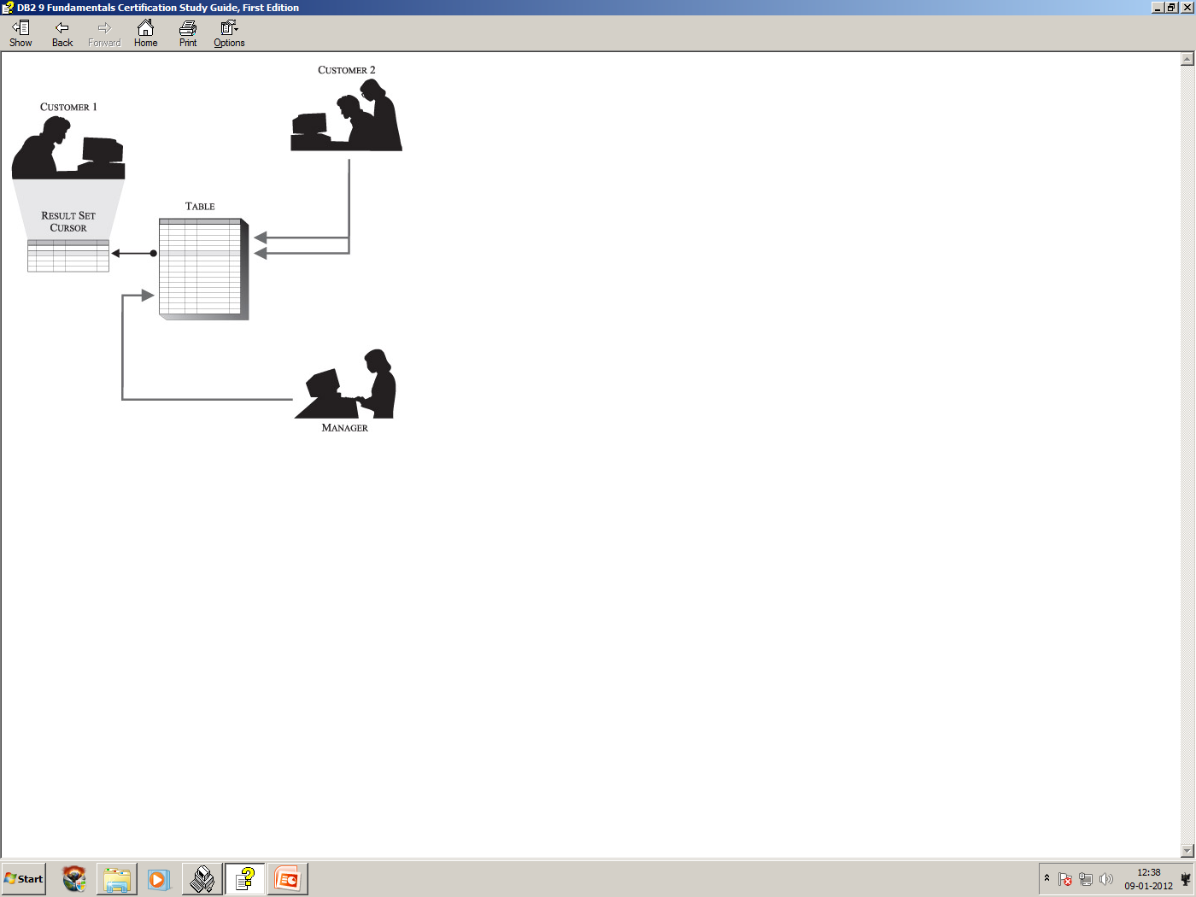

Slide 27
Thank You

